Slide 1
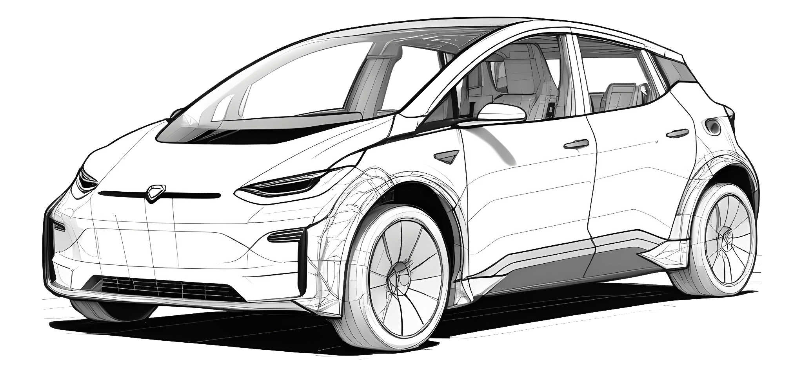
ODYSSEY
Rent a Car , Embark Your Journey
December,5,2024
Page-1

Slide 2

About Us
Masum Billah
Nazirul Islam
ID:ASH2125032
ID: ASH2125023M
Nuzhat Nasrum
Imteaz Ahmed
ID:BFH2125016F
ID:ASH2125035M
December,5,2024
Page-2

Slide 3
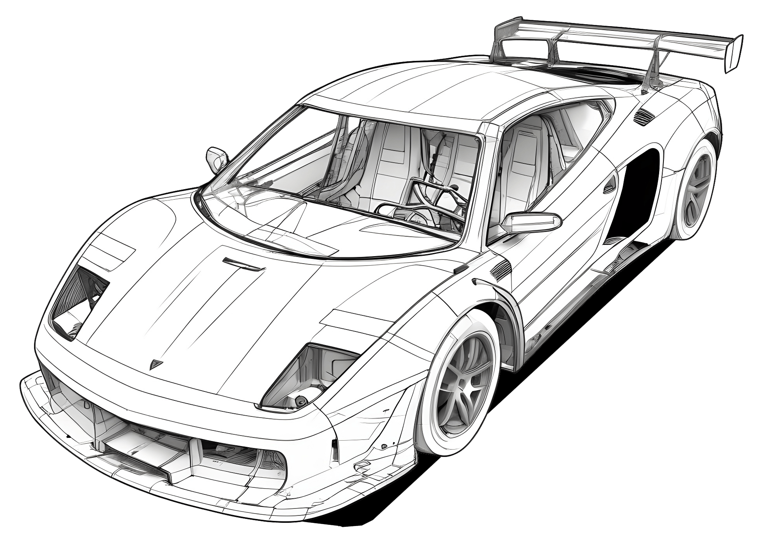
Description
Odyssey aims to revolutionize car rental by improving user experience, streamlining bookings, enhancing feedback, and ensuring transparent pricing. The platform offers a user-friendly interface for seamless vehicle search and booking, robust admin tools for managing accounts, and refunds, and comprehensive vehicle management features for owners, including maintenance and bookings. Odyssey delivers efficiency, reliability, and satisfaction for all stakeholders.
December,5,2024
Page-3

Slide 4
Functional Requirements
Functional requirements are those that serve as examples for the system's internal operation.
Authentication | Users are able to register and authenticate themselves to use the application.
Vehicle Browsing | Users are able to input search criteria such as location, rental dates and budget to find available vehicles that match their needs.
Booking | Users need to enter and confirm their rental details, including pick-up and drop-off dates and locations.
ProfileManagement | Users are able to access their profile to view and update personal details such as name ,email, password.
VehicleManagement | Owners must be able to add new vehicles to the system.
Notifications | The system must not if users and administrators of important events.
December,5,2024
Page-4

Slide 5








Tools and Technologies
Frontend
IDE’s
Android Studio
Vs Code
Backend
December,5,2024
Page-5

Slide 6
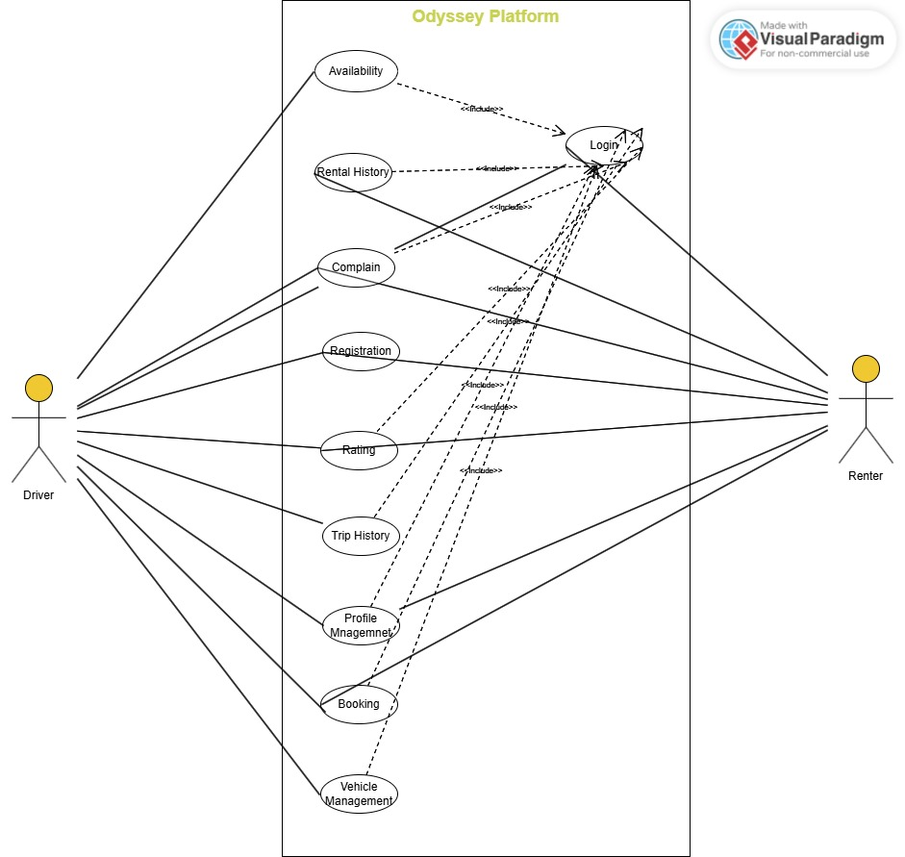
Use Case Diagram:
December,5,2024
Page-6

Slide 7
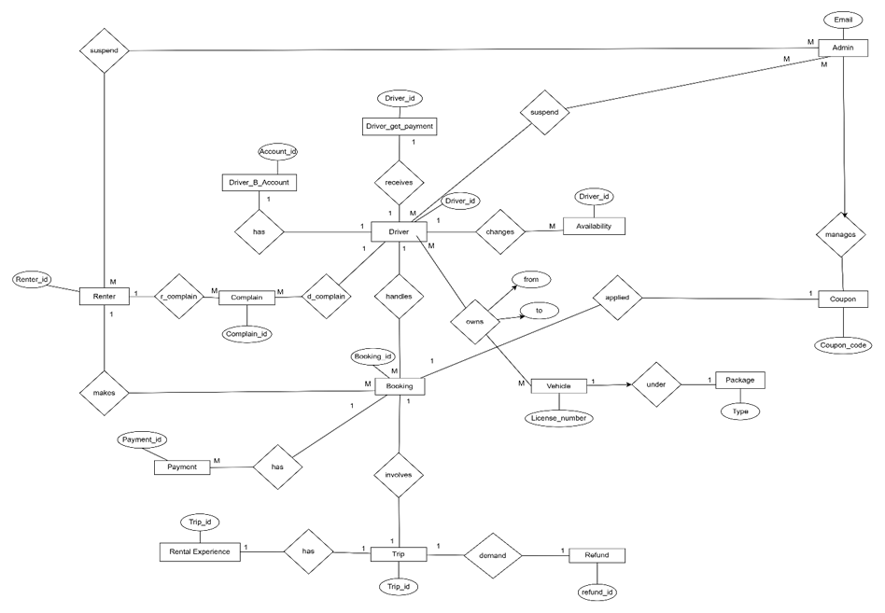
ER-Diagram
December,5,2024
Page-7

Slide 8
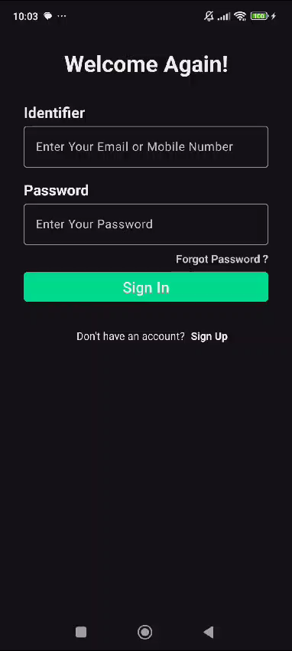
Demo
December,5,2024
Page-8

Slide 9
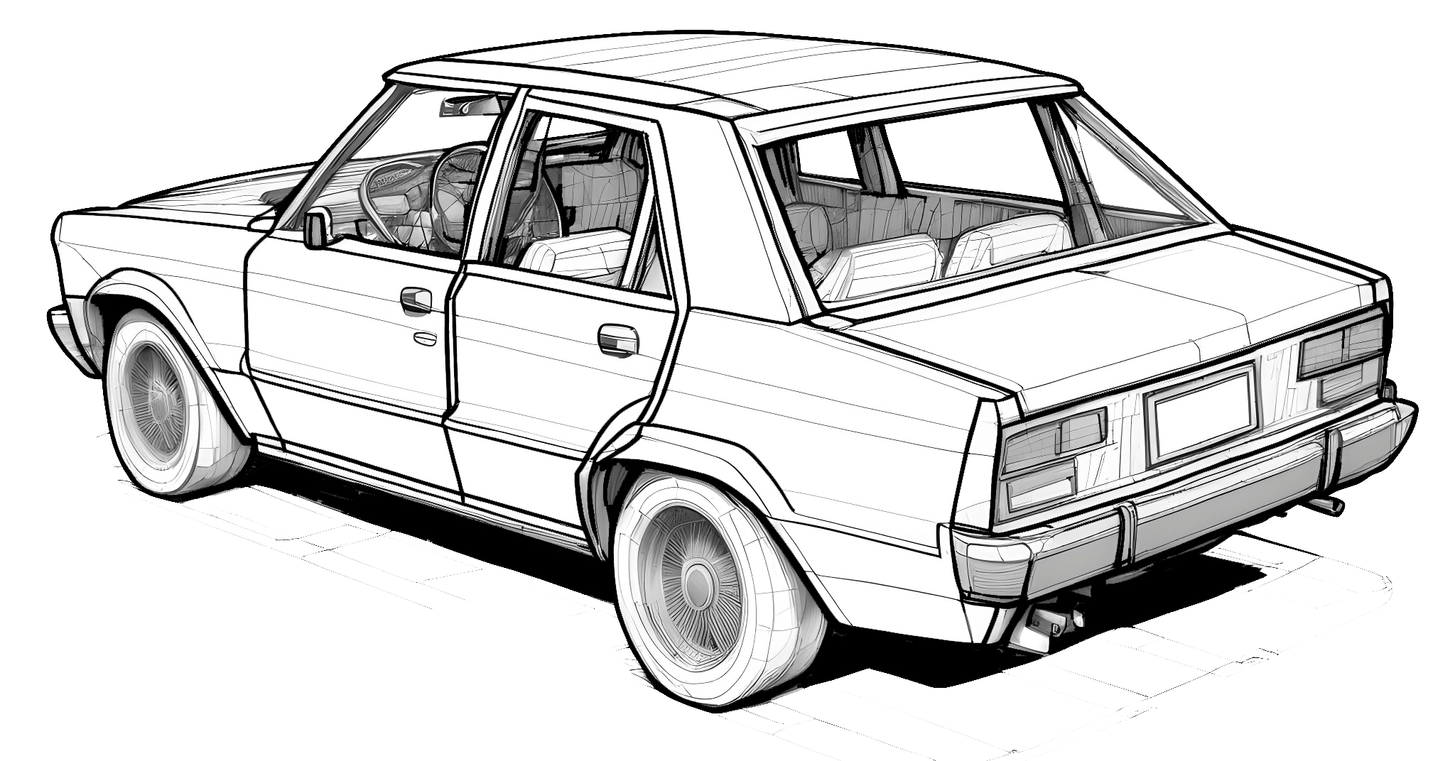
Thank You
December,5,2024
Page-9

